Slide 1

8th Grade Math: Pre-Algebra
Unit 6, Lesson 3 Determining Proportional Relationships Volume 1, pg. 248

Slide 2


Benchmark
MA.8.AR.3.1
Determine if a linear relationship is also a proportional relationship.
volume 1, pg. 248

Slide 3
Integrated Mathematical Thinking and Reasoning Standards
MA.K12.MTR.1.1 Actively participate in effortful learning both individually and collectively.
MA.K12.MTR.2.1 Demonstrate understanding by representing problems in multiple ways.
MA.K12.MTR.4.1 Engage in discussions that reflect on the mathematical thinking of self and others.
MA.K12.MTR.5.1 Use patterns and structure to help understand and connect mathematical concepts.
MA.K12.MTR.6.1 Assess the reasonableness of solutions.
MA.K12.MTR.7.1 Apply mathematics to real-world contexts.
volume 1, pg. 248

Slide 4

Learning Target
I can determine if a linear relationship is also a proportional relationship given a graph, table, equation, or written description.
volume 1, pg. 248

Slide 5

Warm-Up
volume 1, pg. 249

Slide 6


6.3.1 Warm-Up: Would You Rather?
Consider the following situations:
Situation A:
The cost to make $36$ cupcakes is $\$10$. You charge $\$0.50$ per cupcake.
Situation B:
The cost to make $36$ cupcakes is $\$8.00$. You charge $\$18.00$ for all three dozen cupcakes.
Which situation would you rather be in?
volume 1, pg. 249

Slide 7
Explain or show your work to justify your reasoning.
volume 1, pg. 249

Slide 8

Exploration
volume 1, pg. 249

Slide 9

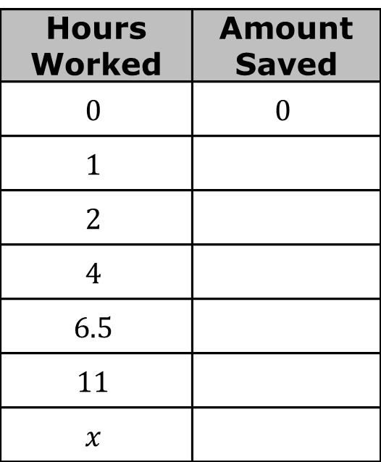
6.3.2 Exploration: Exploring Proportional vs. Non-Proportional Relationships
Work with your partner to complete the following.
Diego earns $10 per hour babysitting. He has no money saved before he starts babysitting and plans to save all of his earnings. Complete the table with Diego’s savings.
Hours Worked | Amount Saved
$$0$$ | $$0$$
$$1$$
$$2$$
$$4$$
$$6.5$$
$$11$$
$$x$$
volume 1, pg. 249

Slide 10

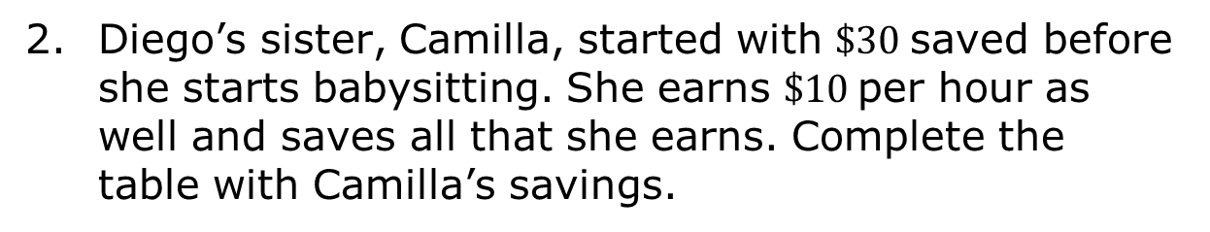
Diego’s sister, Camilla, started with $30 saved before she starts babysitting. She earns $\$10$ per hour as well and saves all that she earns. Complete the table with Camilla’s savings.
Hours Worked | Amount Saved
$$0$$ | $$30$$
$$1$$
$$2$$
$$4$$
$$6.5$$
$$11$$
$$x$$
volume 1, pg. 250

Slide 11
Diego’s savings are modeled by the red line.
Camilla’s savings are modeled by the blue line.
Using evidence from the tables and the graph, explain which line represents a proportional relationship.
Amount Saved (in dollars)
Hours Worked
volume 1, pg. 250

Slide 12
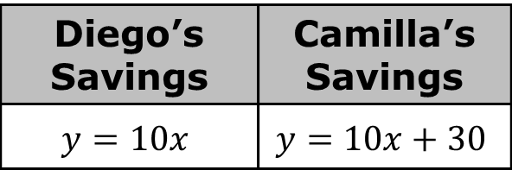
Graphs of proportional relationships meet two criteria. Complete the statements to describe both criteria.
The graph must be ________________.
The graph must cross the coordinates (___, ___).
The equations used to model the savings for Diego and Camilla are shown.
Discuss with your partner the difference between the two equations and explain how to determine if an equation represents a proportional relationship or not.
Diego’s Savings | Camilla’s Savings
$$y=10x$$ | $$y=10x+30$$
volume 1, pg. 251

Slide 13

Guided Practice
volume 1, pg. 251

Slide 14

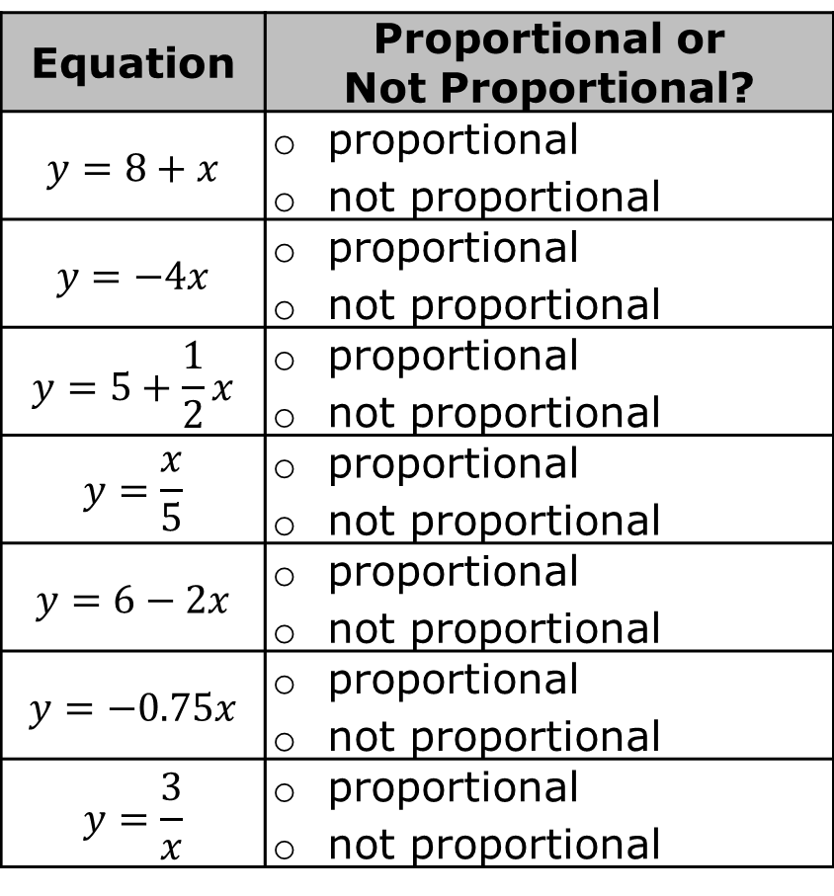
6.3.3 Guided Practice: Determining if a Relationship is Proportional
Identify if each equation is proportional or not. If it is proportional, circle the constant of proportionality in the equation. If it is not proportional, box the portion of the equation that indicates the relationship is not proportional.
Equation | Proportional or Not Proportional?
$$y=8+x$$ | proportional not proportional
$$y=−4x$$ | proportional not proportional
$$y=5+\frac{1}{2}x$$ | proportional not proportional
$$y=\frac{x}{5}$$ | proportional not proportional
$$y=6−2x$$ | proportional not proportional
$$y=−0.75x$$ | proportional not proportional
$$y=\frac{3}{x}$$ | proportional not proportional
volume 1, pg. 251

Slide 15
Jada's grandparents started a savings account for her in 2010. The table shows the amount in the account each year. Explain whether this is a proportional relationship or not.
Years Since 2010 | Amount (in dollars)
0 | 600
2 | 750
4 | 900
6 | 1050
volume 1, pg. 252

Slide 16
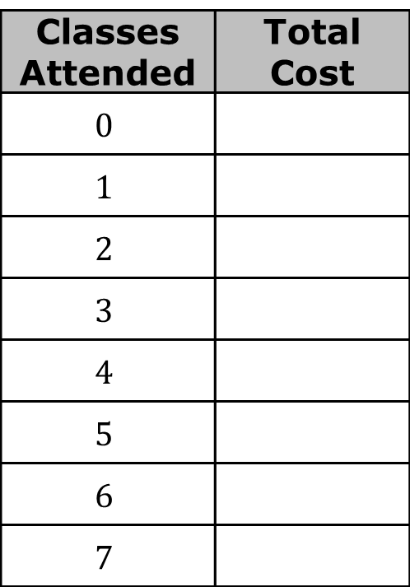
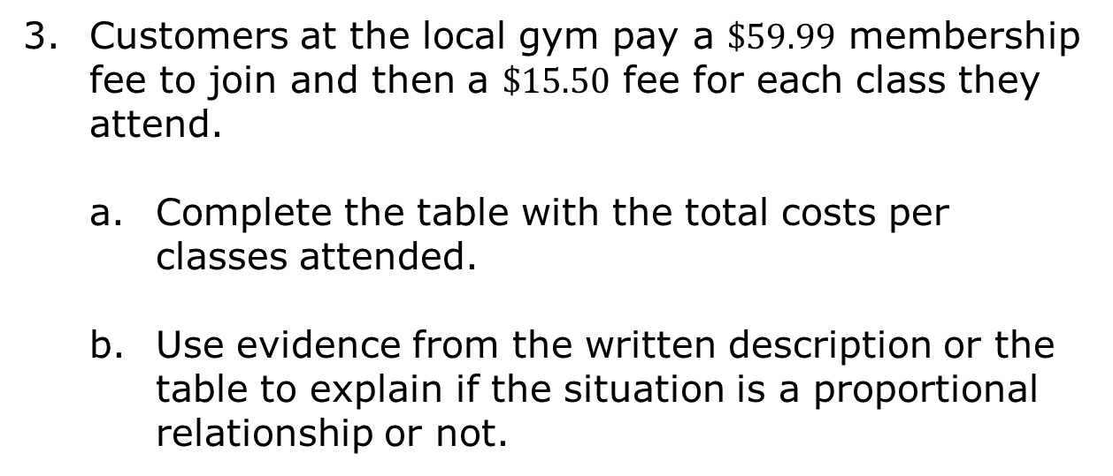
Customers at the local gym pay a $\$59.99$ membership fee to join and then a $\$15.50$ fee for each class they attend.
Complete the table with the total costs per classes attended.
Use evidence from the written description or the table to explain if the situation is a proportional relationship or not.
Classes Attended | Total Cost
$$0$$
$$1$$
$$2$$
$$3$$
$$4$$
$$5$$
$$6$$
$$7$$
volume 1, pg. 252

Slide 17
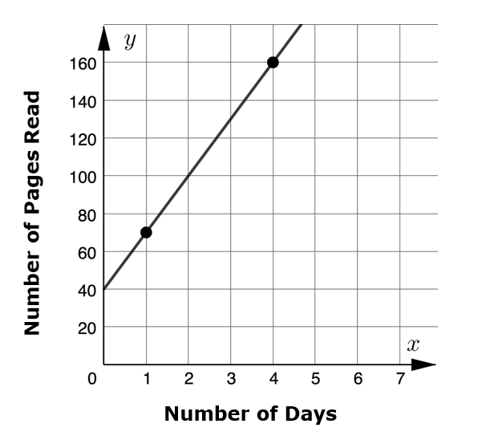
Ashley is reading a book for book club. After reading the first 40 pages of the book in a week, she plans to read 30 pages each day until she finishes to complete the book in time for her next book club meeting. The graph of the situation is shown. Ashley’s friend said the situation is proportional because she reads the same number of pages each day and the graph is a straight line. Use the graph to correct her friend.
volume 1, pg. 253

Slide 18

Wrap-Up
volume 1, pg. 253

Slide 19
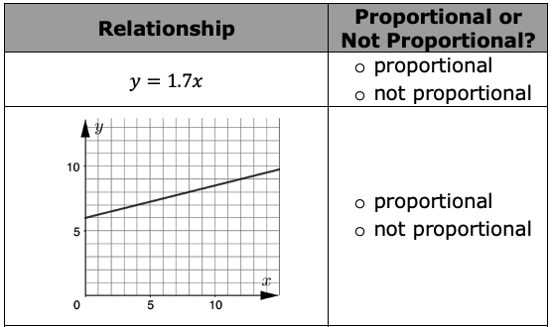
6.3.4 Wrap-Up: Ticket Out the Door
Mark each relationship as either proportional or not proportional.
volume 1, pg. 253

Slide 20
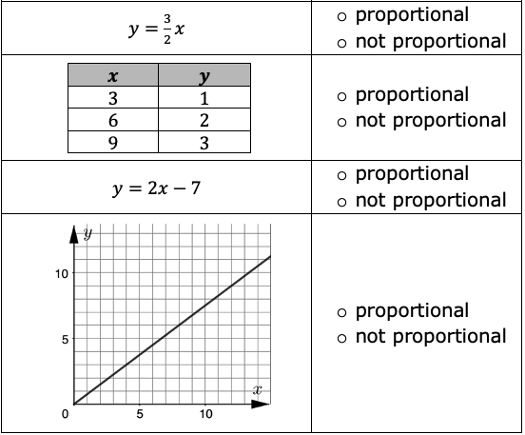
volume 1, pg. 253

